Slide 1
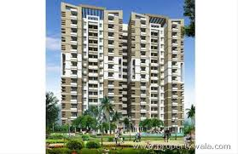
NO - BROKER
HOUSE RENT PREDICTION MODEL

Slide 2
Problem STATEMENT:
Design a machine learning algorithm , to predict the rent of a property .
You have the following details available:
1. 100,000 property data from a particular city which will have around 50 attributes of the property.
2. Data of the neighbourhood of the properties.
You are free to source more data as needed.
Given a new property your algorithm should able to predict the rent range of the property.

Slide 3
Why machine learning ??
Herbert Alexander Simon (Nobel Price Winner)– “Learning is any process by which system improves performance from experience.”
Machine learning is concerned with computer programs that automatically improve their performance through experience.
The output which is to be predicted depends on various independent attributes, so to find the output we will have to learn from previous experience that is why we use Machine Learning.

Slide 4
Why nobroker ?
Lets us take an example from our engineering life, where a student from outside city comes to take admission in any college we have to take a house or property on rent then the solution is Nobrokers.
If I am an employee going to be shifted in a new city then I can easily check the rent and there will be no any mediator who will impose his revenue to find a property to me, then I have Nobrokers.

Slide 5
Current issues:
Authenticity issues
Biased advertising
Working on metropolitan cities only.
No trends analysis of properties locality wise in a particular cities.
Some additional features are missing which can improvise the user experience .

Slide 6
Additional features
More efficiency from previous models available.
Loan prediction for user.
Keeping in mind government project: Jan Aawaas Yojana
Authenticity of properties are verified by visiting onsite.
Trends in the properties according to respective localities.
No biased advertisement.

Slide 7
SOFTWARE USED:
FRONT END
HTML and CSS
CGI Scripting
Apache Server
Android Studio 3.x
BACK END
Python 3.x
Anaconda3-4.2.0

Slide 8
Steps of solving problem:
Analysing the problem.
Analysing and pre-processing the data set.
Visualisation of dataset.
Imputing the missing values.
Removing the outliers.
Encoding the categorical features
Scaling of the dataset.
Fitting the model using machine learning lgorithms.
Predicting the output.

Slide 9
VISUALISING THE DATA SET

Slide 10
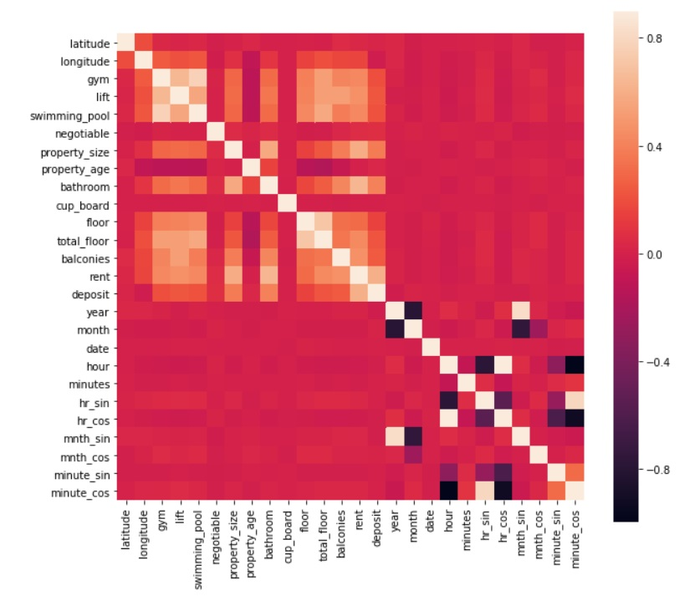
HEATMAP FOR DEFINING CORRELATION BETWEEN ATTRIBUTES

Slide 11
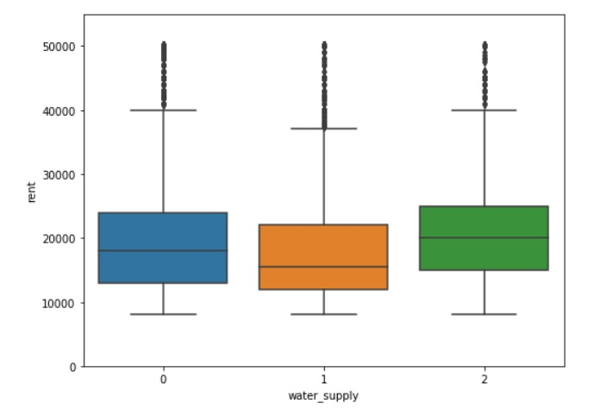
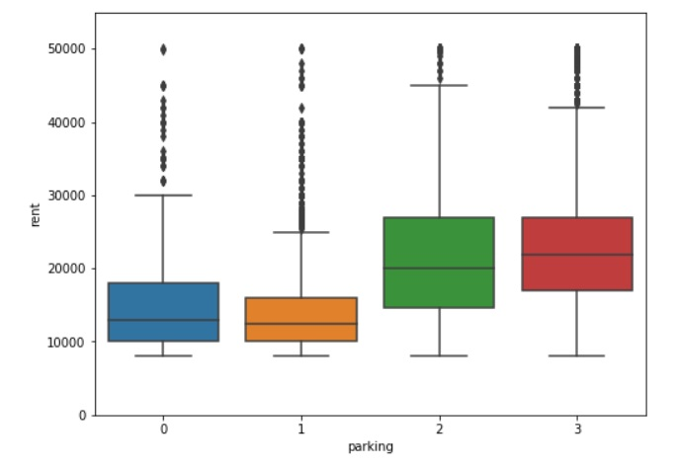
DEPENDENDENCE ON OUTPUT

Slide 12
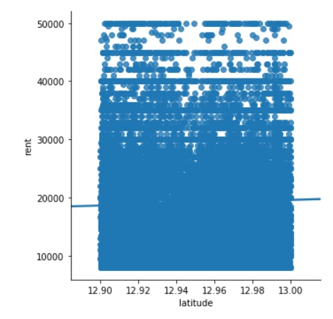
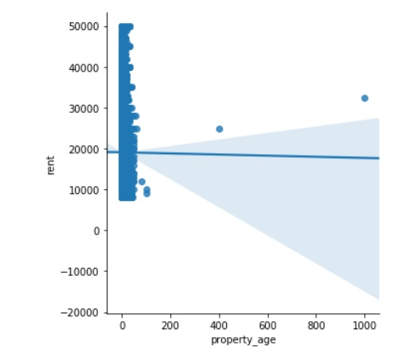
DEPENDENCE ON OUTPUT

Slide 13
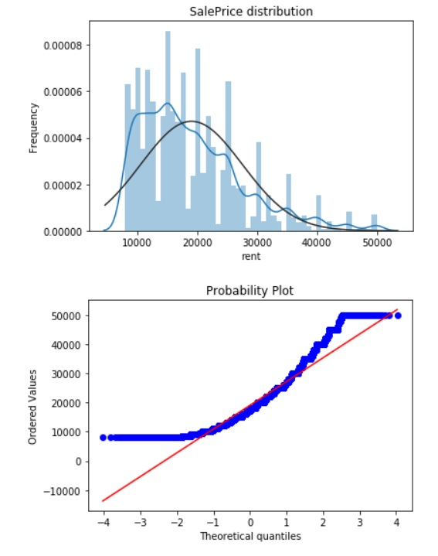
DISTRIBUTION PLOT OF OUTPUT DEPENDENT VARIABLE i.e. RENT

Slide 14
PROPOSED SOLUTION:
The above problem statement can be solved by using the following algorithms of machine learning:
Gradient Boost
XG Boost
Linear Regression
Lasso Regression
Ridge Regression
Elastic Net Regression

Slide 15
Revenue model:
To generate maximum profit of the given model, we will use following business strategies:
Few of the properties owners complete information will be displayed, if the user is satisfied by these properties he/she can opt to become a prime subscribers.
Earning referral fee by recommending packers and movers, companies renting furniture and interior designer companies.
Displaying advertisements on our website and the android app.
User can opt for insurance which will provide company profits under some conditions.

Slide 16
Conclusion:
Hence we have developed the model which will predict rent of the property according to the features specified by the user and rent will be predicted as the output. At last implementing all the above algorithms , we came to a solution that using multiple regression leads us to best score and least error(root mean square) in the prediction of the model.

